Slide 1

Class1
CSC 495/583 Topics of Software Security Introduction
Dr. Si Chen (schen@wcupa.edu)

Slide 2
What is computer security?
•
Most developers and operators are concerned with
correctness: achieving desired behavior
A working banking web site, word processor, blog, …
•
•
Security is concerned with preventing undesired behavior
Considers an enemy/opponent/hacker/adversary who is actively and maliciously trying to circumvent any protective measures you put in place
•

Slide 3
Security Expectations
Confidentiality: requires that information be kept private
Integrity: the trustworthiness and correctness of data.
Availability: the capability to use information and resources.

Slide 4
Kinds of undesired behavior
•
Stealing information:confidentiality
•
Corporate secrets (product plans, source code, …) Personal information (credit card numbers, SSNs, …)
•
•
Modifying information or functionality:integrity
•
Installing unwanted software (spyware, botnet client, …) Destroying records (accounts, logs, plans, …)
•
•
Denying access:availability
•
Unable to purchase products
Unable to access banking information
•

Slide 5
Significant security breaches
•
RSA, March 2011
stole tokens that permitted subsequent compromise of customers using RSA SecureID devices
•
•
Adobe, October 2013
stole source code, 130 million customer records (including passwords)
•
•
Target, November 2013
stole around 40 million credit and debit cards
•
•
… and many others!

Slide 6
Vulnerabilities
Vulnerabilities: specific flaws or oversights in a piece of software that allow attackers to do somethings malicious
Software vulnerabilities can be thought of as a subset of the larger phenomenon software bugs
Many breaches begin by exploiting a vulnerability -- This is a security-relevant software defect that can be exploited to effect an undesired behavior
“A complex program, written by a team of experts and deployed around the world for more than a decade, can suddenly be co-opted by attackers for their own means. The whole process as some form of digital voodoo”

Slide 7
Example: RSA 2011 breach
•
Exploited an Adobe Flash player vulnerability
A carefully crafted Flash program, when run by the vulnerable Flash player, allows the attacker to execute arbitrary code on the running machine
This program could be embedded in an Excel spreadsheet, and run automatically when the spreadsheet is opened
The spreadsheet could be attached to an e-mail masquerading to be from a trusted party (spear phishing)

Slide 8
Considering Correctness
•
The Flash vulnerability is an implementation bug
All software is buggy. So what?
•
•
A normal user never sees most bugs, or works around them
Most (post-deployment) bugs due to rare feature interactions or failure to handle edge cases
•
•
Assessment: Would be too expensive to fix every bug before deploying
So companies only fix the ones most likely to affect normal users
•

Slide 9
Considering Security
The adversary will actively attempt to find defects in rare feature interactions and edge cases
For a typical user, (accidentally) finding a bug will result in a crash, which he will now try to avoid
An adversary will work to find a bug and exploit it to achieve his goals
Key difference:
An adversary is not a normal user!

Slide 10
To ensure security, we must
eliminate bugs and design flaws, and/or
make them harder to exploit

Slide 11
What is Software Security?

Slide 12
Software Security
Software security focuses on the secure design and implementation of software
Focus of study:
the (source) code
By contrast: Many popular approaches to security treat software as a black box (ignoring the code)
OS security, anti-virus, firewalls, etc.

Slide 13
Course overview
•
This course is primarily aimed at student interested in
secure software development, who will
•
Design software systems that should be secure
Write code that should be secure Review code that should be secure Test code that should be secure
•
•
•
•
We will connect to other classes in the WCU
CSC 301…
•
Much of our focus will be on the software, and how to develop it to be secure

Slide 14
Expected background
•
Roughly: knowledge of a junior-level undergraduate majoring in computer science
•
Knowledge with the following
•
Programming in general (e.g. Java)
•
Familiarity with the following:
•
Unix/Linux including the command-line shell and gdb The web (HTML, HTTP, TCP, network communications) Intel x86 assembly language and architecture
•
•

Slide 15

Learning Software Security
•
Our goal is learn how to make more secure software
Better design
Better implementation Better assurance
•
•
•
How should we go about this?

Slide 16


Black Hat, White Hat
Black hat
•
What are the security-relevant defects
that constitute vulnerabilities?
How are they exploited?
•
White hat
•
How do we prevent security-relevant defects (before deploying)?
How do we make vulnerabilities we don’t manage to avoid harder to exploit?
•
During the course we will wear both hats

Slide 17
Low-level Vulnerabilities
•
Programs written in C and C++ are susceptible a variety of dangerous vulnerabilities
•
Buffer overflows
On the stack On the heap
Due to integer overflow
Over-writing and over-reading
Format string mismatches Dangling pointer dereferences
Attacks
Stack smashing
Format string attack
Stale memory access
Return-oriented Programming (ROP)
-
-
-
-
•
•
•
All violations of memory safety
Accesses to memory via pointers that don’t own that memory
•

Slide 18
Ensuring Memory Safety
•
The easiest way to avoid these vulnerabilities is to
use a memory-safe programming language
•
Better still: a type-safe language
•
For C/C++, use automated defenses
•
Stack canaries
Non-executable data (aka W+X or DEP) Address space layout randomization (ASLR) Memory-safety enforcement (e.g., SoftBound) Control-flow Integrity (CFI)
•
•
•
•
•
and safe programming patterns and libraries
•
Key idea: validate untrusted input

Slide 19

Web Security
There are new vulnerabilities and attacks
SQL injection
Cross-site scripting (XSS)
Cross-site request forgery (CSRF) Session hijacking
The defenses have a similar theme:
Careful who/what you trust: Validate input
Reduce the possible damage, make exploitation harder

Slide 20
Requirements and Design
•
Identify sensitive data and resources and define security requirements for them, like confidentiality, integrity, and availability
Consider expected threats and abuse cases that could violate these requirements
•
•
Apply principles for secure software design
To prevent, mitigate, and detect possible attacks Main categories: Favor Simplicity, Trust with Reluctance, and Defend in Depth.
•
•

Slide 21
Rules and Tools
•
Apply coding rules to implement secure design With similar goals of preventing, mitigating, or detecting possible attacks
•
•
Apply automated code review techniques to find potential vulnerabilities in components
Static analysis, and symbolic execution (which underlies whitebox fuzz testing)
•
•
Apply penetration testing to find potential flaws in the real system, in a deployment environment
Fuzz testing, perhaps employing attack patterns
•

Slide 22
Example

Slide 23

Heartbleed
CVE-2014-0160

Slide 24
Heartbleed
Description
The (1) TLS and (2) DTLS implementations in OpenSSL 1.0.1 before 1.0.1g do not properly handle Heartbeat Extension packets, which allows remote attackers to obtain sensitive information from process memory via crafted packets that trigger a buffer over-read, as demonstrated by reading private keys, related to d1_both.c and t1_lib.c, aka the Heartbleed bug.

Slide 25
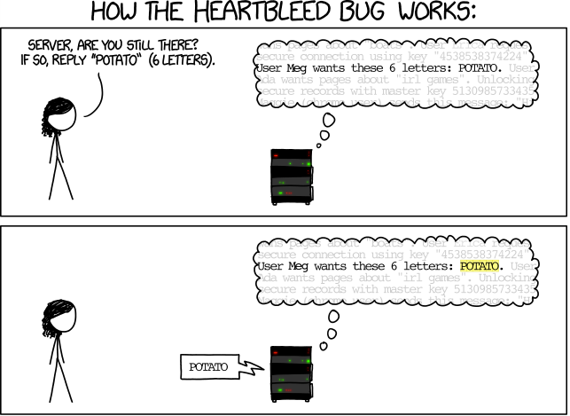
How The Heartbleed bug works
http://imgs.xkcd.com/comics/heartbleed_explanation.png

Slide 26
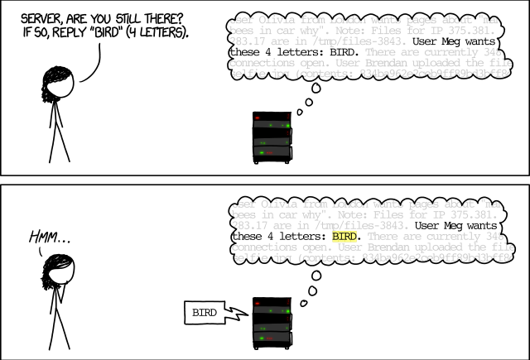
How The Heartbleed bug works
http://imgs.xkcd.com/comics/heartbleed_explanation.png

Slide 27
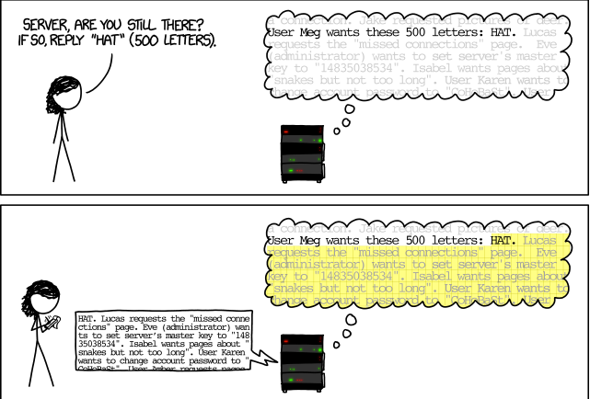
How The Heartbleed bug works
http://imgs.xkcd.com/comics/heartbleed_explanation.png

Slide 28

Heartbleed and OpenSSL
OpenSSL is an open-source cryptography library, widely used to implement the Internet’s Transport Layer Security (TLS) protocol.
https://scienceofbusiness.files.wordpress.com/2014/04/heartbleed-openssl-bug.jpg

Slide 29
No boundary check.
The attacker controls both of these length fields!

Slide 30
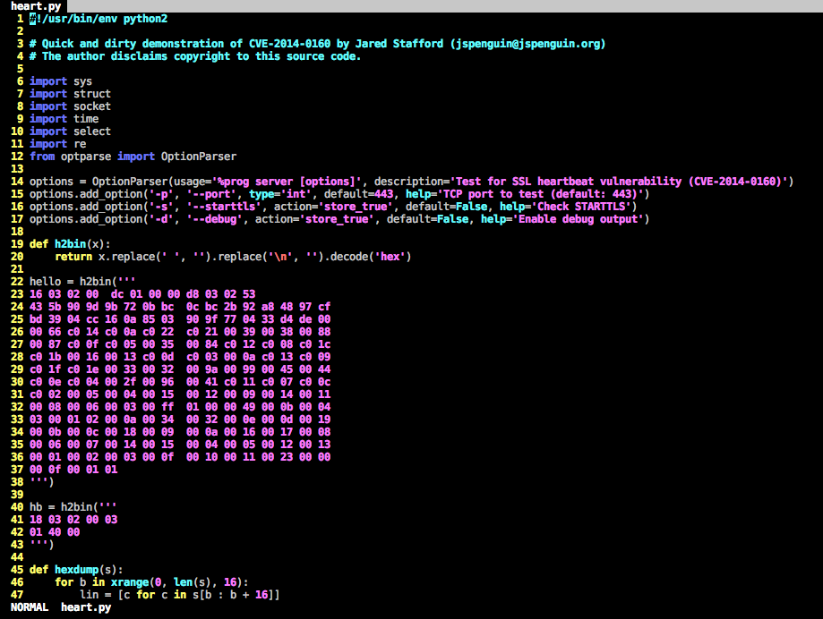
Exploit Shellcode

Slide 31
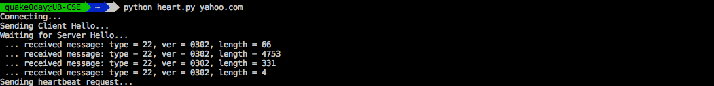
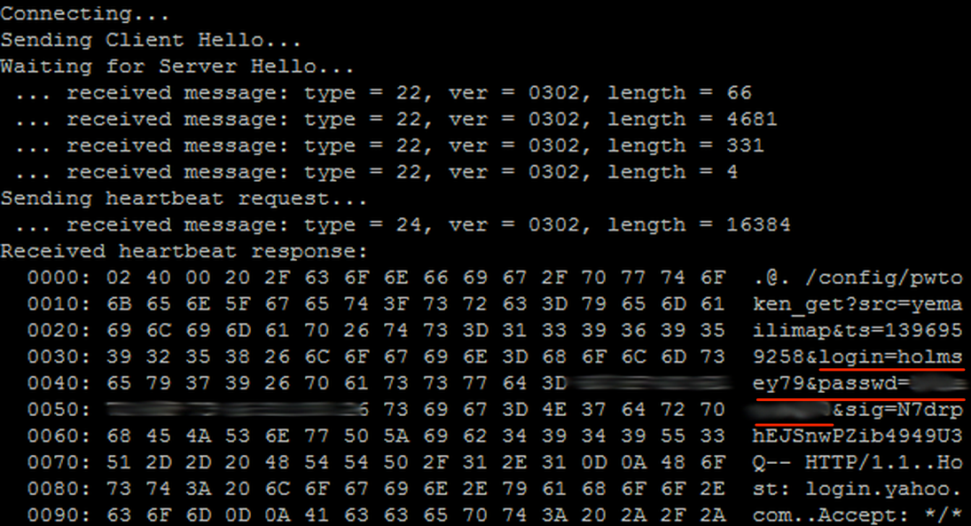
Heartbleed Attack

Slide 32

0day
A 0day vulnerability is an undisclosed computer-software vulnerability that hackers can exploit to adversely affect computer programs, data, additional computers or a network.
It is known as a ”0day" because it is not publicly reported or announced before becoming active, leaving the software's author with zero days in which to create patches or advise workarounds to mitigate its actions.
https://www.exploit-db.com/

Slide 33
PoC and Exploit
PoC (Proof of Concept): An attack against a computer or network that is performed only to prove that it can be done. It generally does not cause any harm, but shows how a hacker can take advantage of a vulnerability in the software or possibly the hardware.
Exploit: An unethical or illegal attack that takes advantage of some vulnerability.

Slide 34
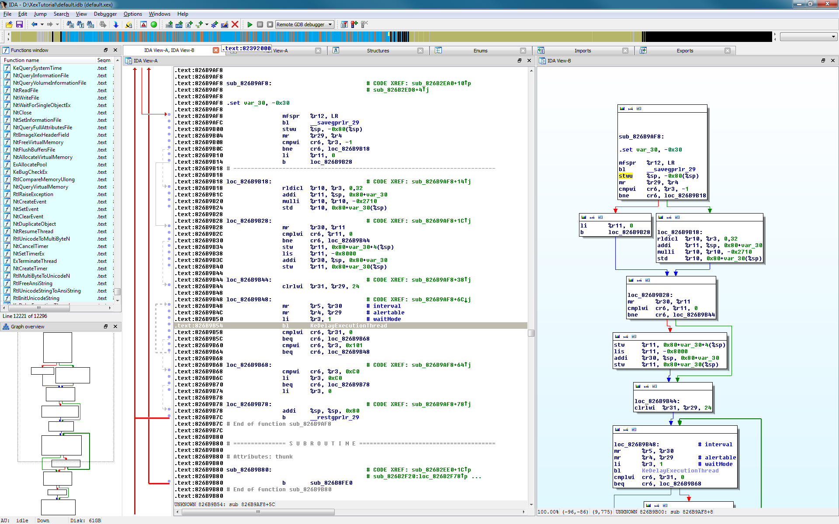
Code Analysis Tools: IDA Pro
IDA Starter Licenses: $739
IDA Professional Licenses $1409

Slide 35
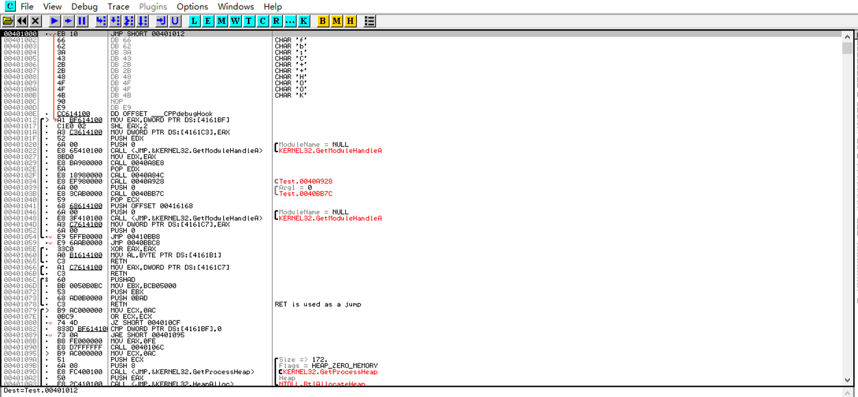
Code Analysis Tools: OllyDbg
OllyDbg is a 32-bit assembler level analyzing debugger Microsoft® Windows®. OllyDbg is a shareware, but you can download and use it for free.

Slide 36
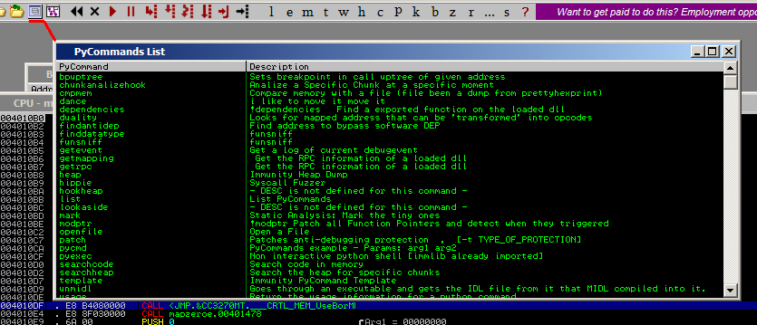
Code Analysis Tools: Immunity Debugger
Immunity Debugger is a powerful new way to write exploits, analyze malware, and reverse engineer binary files.
It has a large and well supported Python API for easy extensibility.
Notes:
Immunity Debugger is a powerful new way to write exploits, analyze malware, and reverse engineer binary files. It builds on a solid user interface with function graphing, the industry's first heap analysis tool built specifically for heap creation, and a large and well supported Python API for easy extensibility.

Slide 37
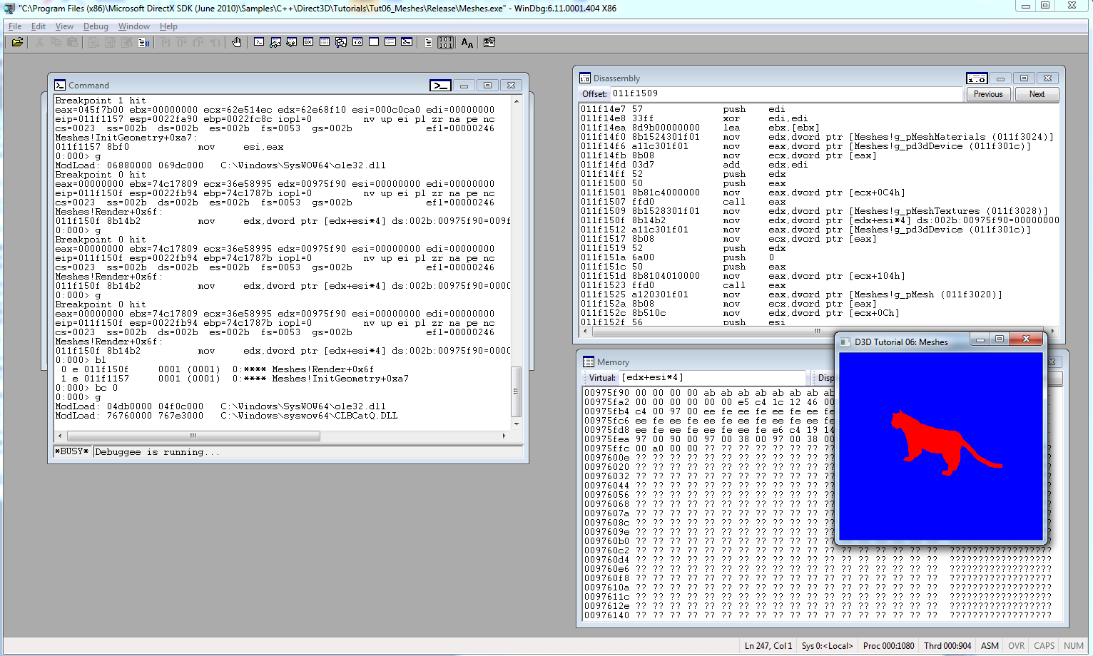
Code Analysis Tools: WinDbg
The Windows Debugger (WinDbg) can be used to debug kernel and user mode code, analyze crash dumps and to examine the CPU registers as code executes.

Slide 38
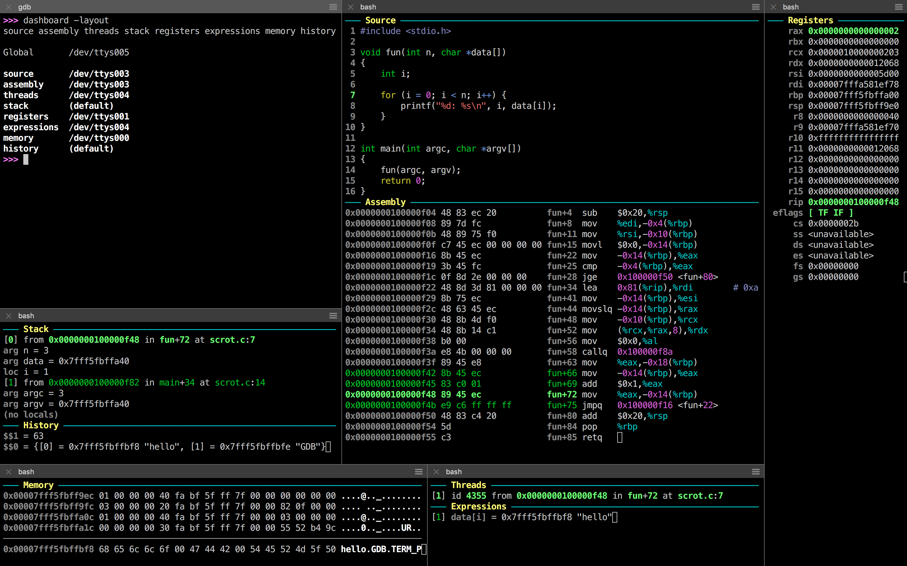
Code Analysis Tools: GDB
GDB, the GNU Project debugger, allows you to see what is going on `inside' another program while it executes -- or what another program was doing at the moment it crashed.

Slide 39
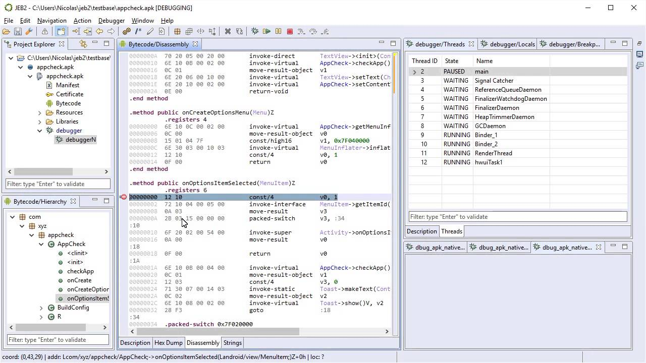
Code Analysis Tools: JEB
The Android debuggers

Slide 40
Static analysis and Dynamic analysis
Static analysis is a method of computer program debugging that is done by examining the code without executing the program.
Dynamic analysis is the testing and evaluation of a program by executing data in real-time.

Slide 41

Q & A

